Slide 1



C# Music Player
Developed by Chen Chen and Jun Yang

Slide 2
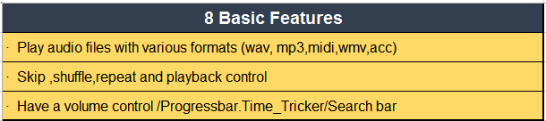

Slide 3
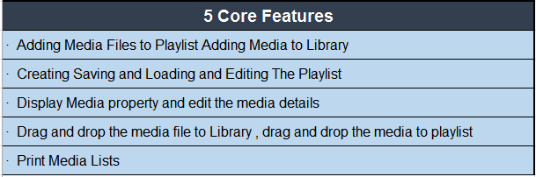




Slide 4
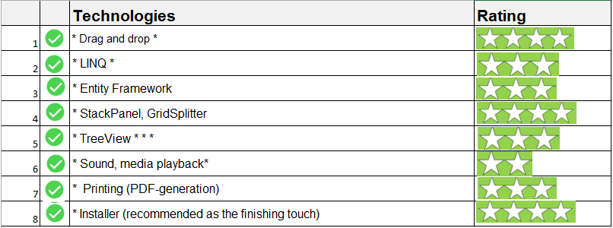
Overview

Slide 5
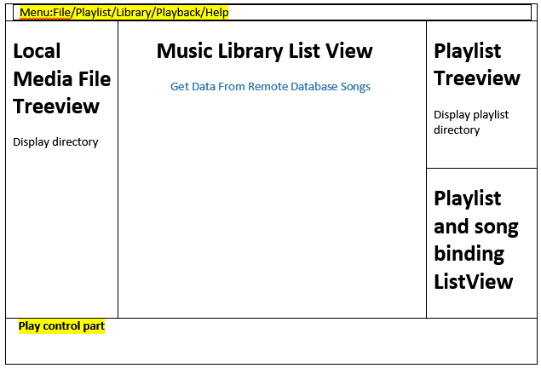
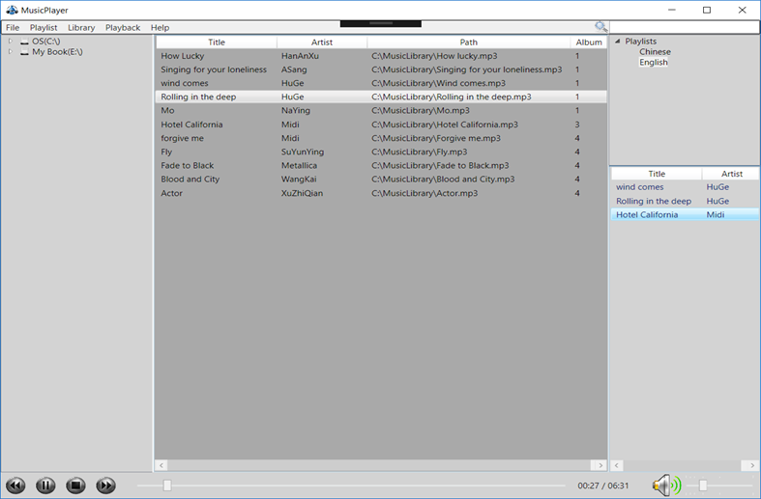
UI Design

Slide 6
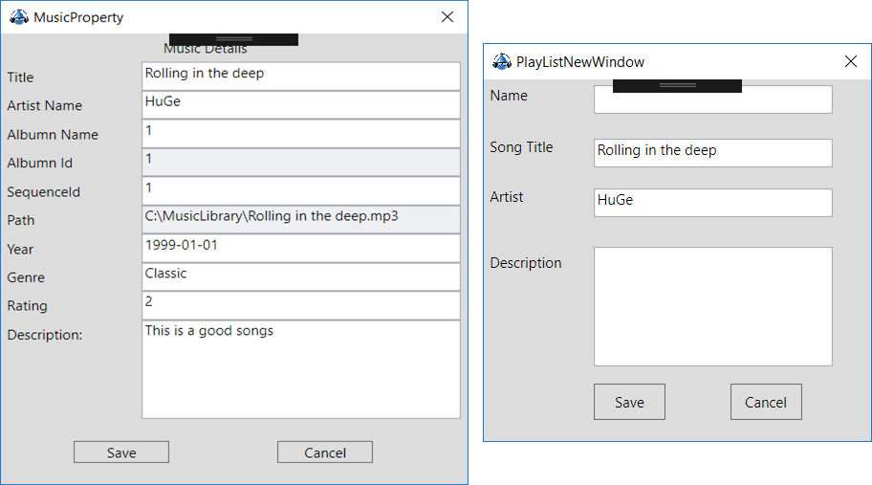
Save Data to Database

Slide 7
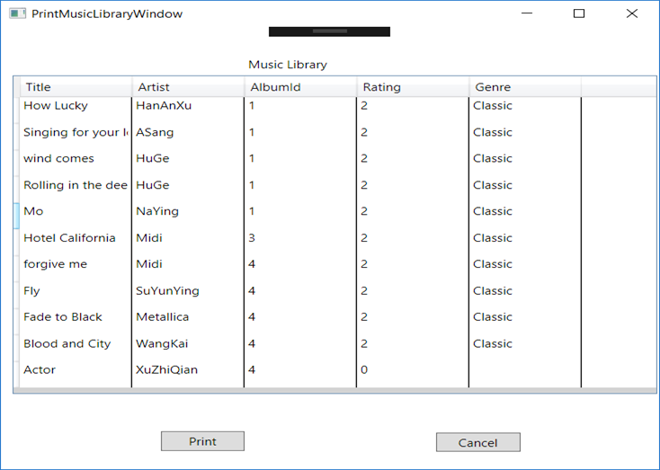
Challenge
Print
StackPanel
DataDrid
PrintDialog Class
DataDrid ItemsSource = ListMusicLibrary
PrintDialog.PrintVisual(datagridPack, "Grid Printing.")

Slide 8
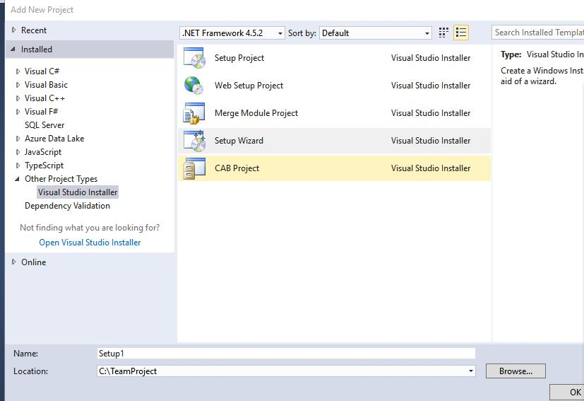

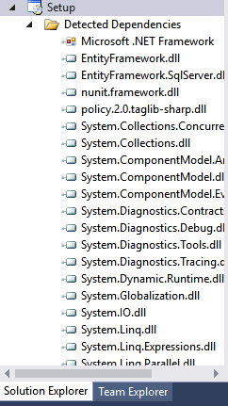
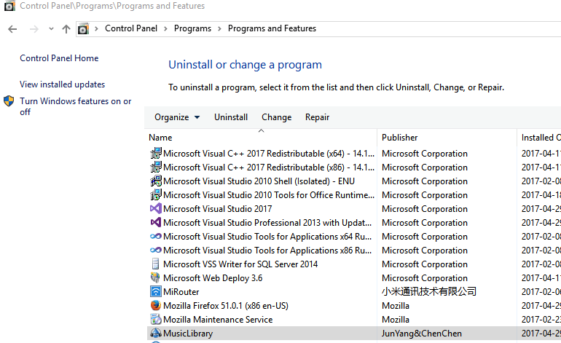
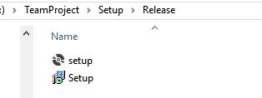
Installer

Slide 9
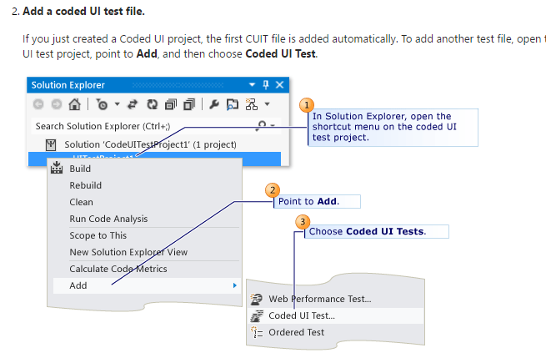
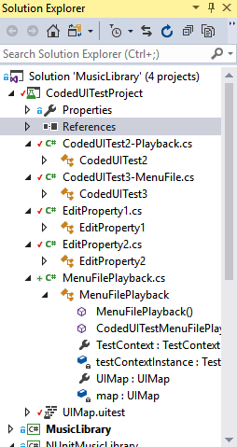
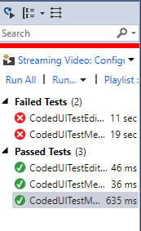
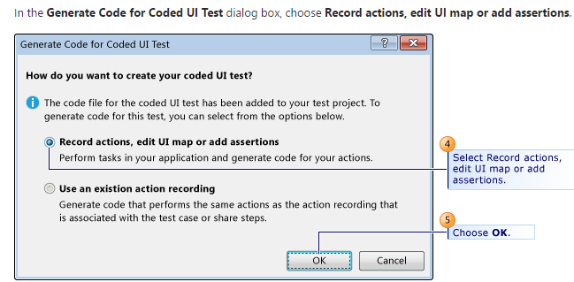
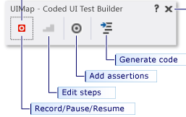
Testing

Slide 10
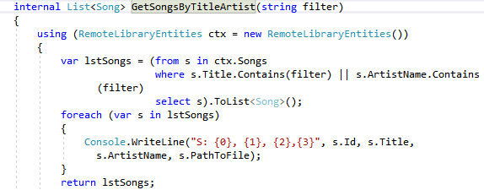
Search Bar with LINQ

Slide 11
Challenge - Drag and drop
Detect a drag
Create a DataObject
DoDragDrop()
Set the AllowDrop property
Register a handler to the DragEnter event
Call GetDataPresent()
DragDrop event and GetData()

Slide 12

What We Learn
So many problems …. I have been met.
1 installer-> empty folder
(No .NET framework)
2 fatal error 1603
3 Merge version -> Fetal Error
Cannot resolve dependency to assembly 'Microsoft.VisualStudio.TestTools.UITest.Extension, it has not been preloaded. When using the ReflectionOnly APIs,

Slide 13
Future Work
More test work
Support more format
Support video
Library Management, such as album management, print playlist.

Slide 14
Summary
Implement is not easy
Testing and re-do coding
Spend more time in the phase of Design
Version Control is very important

